Slide 1
End Here May 27th
Begin Here June 3rd, 2020

Slide 2
Absence of Copyright
This slideshow contains photos, diagrams, and information, some of which were attained through internet searches of public websites. The author of this presentation does not own the copyright on this information, so this slideshow is for personal use only—not for sale or profit. Please utilize it to seek the Lord and grow in your knowledge of His Word and ways.

Slide 4
Prayer and Announcements
Sunday: 9:15 Fellowship
9:30 SS Master Class
10:30 Worship
Revelation Study available on our church website
www.faithprinceton.org
Email questions and comments to
pastor@faithprinceton.org

Slide 5
Prayer and Announcements
“Black Lives Matter” in Princeton Friday
Jesus loves all, and so do we.
We stand against racial discrimination of any kind. We are one in Christ Jesus.
Pray for Peace and Unity.

Slide 7
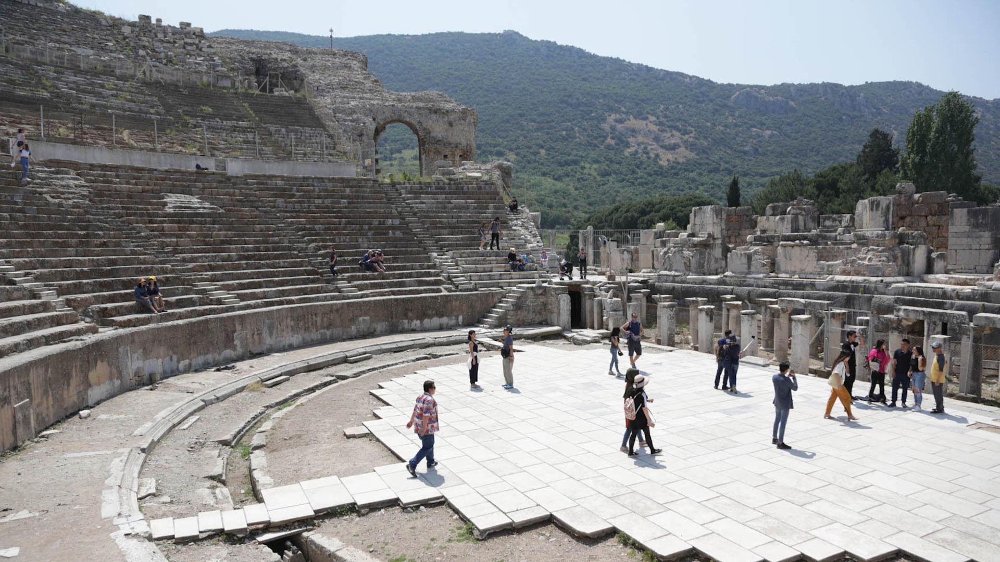
Ephesus – Revelation 2:1-7
What Happened to the Seven Churches of Revelation?
By Madeline Arthington and Karrie Sparrow
https://www.imb.org/2018/06/01/what-happened-to-the-seven-churches-of-revelation/
The amphitheater where the riot in Acts 19 broke out has also been the venue for rallies and concerts. Sting, Elton John, and Diana Ross are among those who have performed there.
Photo by Karrie Sparrow.
Notes:
https://www.imb.org/2018/06/01/what-happened-to-the-seven-churches-of-revelation/
What Happened to the Seven Churches of Revelation?
By Madeline Arthington and Karrie Sparrow
Ephesus-Selçuk
Ephesus was the fourth largest city of the Roman empire in the first century. A thriving commercial center and port city, Ephesus was also the home of a temple to the goddess Artemis. The amphitheater in Ephesus, which could hold up to twenty-five thousand people, was the venue of the angry riot against Christians in Acts 19.
In Revelation, Jesus commended the Ephesian church for enduring hardships and hating the heresy of the Nicolaitans—early Gnostics who wanted to blend Christianity with pagan practices like sexual immorality. But others in Ephesus had fallen from their first love of Christ and received a sober warning: “Repent and do the things you did at first” (Rev. 2:5 NIV). Some scholars think these Christians may have caved to pressure to worship at the cult temple of Emperor Domitian.
The remains of a temple possibly built for Emperor Domitian during the first century. Domitian persecuted the early church and is responsible for exiling the apostle John to Patmos. Photo by Karrie Sparrow.
Over time, Ephesus physically shifted to what is now the small town of Selçuk, only a five-minute drive from the Ephesus ruins. Honeysuckle perfumed the air around the shops and streets I visited. The town is Muslim—as is 99 percent of Turkey. Even so, a small Protestant church of former-Muslim believers gathers in Selçuk for worship and fellowship.

Slide 8
Ephesus – Revelation 2:1-7
Message:
Remember the heights
Repent of the fall
Re-do the things you did at first
Notes:
Tyndale Commentary
The Greek imperative is present, with a meaning like ‘keep on remembering’, ‘hold in memory’. They had enjoyed a close walk with God. Let their minds dwell on that. The second step is repent (the aorist points to a sharp break with evil). Christians can never dally with wrong. There must be a sharp break with it. But Christianity is not basically negative and the third step is do the things you did at first, i.e. the works that had issued from their first love.
EPHESIANS 3:14-21
For this reason I bow my knees before the Father, from whom every family in heaven and on earth derives its name, that He would grant you, according to the riches of His glory, to be strengthened with power through His Spirit in the inner man, so that Christ may dwell in your hearts through faith; and that you, being rooted and grounded in love, may be able to comprehend with all the saints what is the breadth and length and height and depth, and to know the love of Christ which surpasses knowledge, that you may be filled up to all the fullness of God. Now to Him who is able to do far more abundantly beyond all that we ask or think, according to the power that works within us, to Him be the glory in the church and in Christ Jesus to all generations forever and ever. Amen.
Ephesians 3:14‭-‬21 NASB
https://bible.com/bible/100/eph.3.14-21.NASB

Slide 9
Smyrna – Revelation 2:8-11
Notes:
Smyrna-Izmir
Dispensational View – from the death of the Apostles until Constantine AD 170-312
*** Very limited Protestant view by the way. You would never find a Catholic or Orthodox Christian who accepted this view. The pope and Roman Catholic church becomes the symbol of AntiChrist in this view. Very dangerous view if it is not entirely correct.
Historical View – a church facing persecution in Asia Minor
Spiritual View – Being faithful during times of persecution

Slide 10
Smyrna – Revelation 2:8-11
⁸ “And to the angel of the church in Smyrna write:
The first and the last, who was dead, and has come to life, says this:
⁹ ‘I know your tribulation and your poverty (but you are rich), and the blasphemy by those who say they are Jews and are not, but are a synagogue of Satan. ¹⁰ Do not fear what you are about to suffer. Behold, the devil is about to cast some of you into prison, so that you will be tested, and you will have tribulation for ten days. Be faithful until death, and I will give you the crown of life. ¹¹ He who has an ear, let him hear what the Spirit says to the churches. He who overcomes will not be hurt by the second death.’
Notes:
Smyrna-Izmir
Dispensational View – from the death of the Apostles until Constantine AD 170-312
Historical View – a church facing persecution
Spiritual View – Being faithful during times of persecution

Slide 11
Smyrna – Revelation 2:8-11
Introduction/Description of Jesus
⁸ The first and the last, who was dead, and has come to life, says this:
Praise/Commendation
⁹ ‘I know your tribulation and your poverty (but you are rich), and the blasphemy by those who say they are Jews and are not, but are a synagogue of Satan.
Extreme poverty
Synagogue of Satan = anyone who stands opposed to Christ
Notes:
NOTE: “smyrna” = “myrrh” = a burial ointment
“was dead” = “became dead” (aorist = past tense = happened in history, but eternal nature is “the Living One”)

Slide 12
Smyrna – Revelation 2:8-11
Condemnation/Rebuke
NONE!
Charge/Challenge
¹⁰ Do not fear what you are about to suffer. Behold, the devil is about to cast some of you into prison, so that you will be tested, and you will have tribulation for ten days. Be faithful until death…
¹⁰ Do not fear what you are about to suffer.
The devil is about to cast some of you into prison, so that you will be tested
you will have tribulation for ten days = emphasizes temporary or testing (Daniel 1)
Be faithful until death…
Notes:
Tribulation for Ten days = ?Possibly… ten waves of Christian persecution in the early church before Constantine?
?Or ten days of testing of Daniel and friends?
Daniel 1:11-15
But Daniel said to the overseer whom the commander of the officials had appointed over Daniel, Hananiah, Mishael and Azariah, “Please test your servants for ten days, and let us be given some vegetables to eat and water to drink. Then let our appearance be observed in your presence and the appearance of the youths who are eating the king’s choice food; and deal with your servants according to what you see.” So he listened to them in this matter and tested them for ten days. At the end of ten days their appearance seemed better and they were fatter than all the youths who had been eating the king’s choice food.
Daniel 1:11‭-‬15 NASB
https://bible.com/bible/100/dan.1.11-15.NASB

Slide 13
Smyrna – Revelation 2:8-11
Consequences
¹⁰ Be faithful until death, and I will give you the crown of life.
Promise
¹¹ He who has an ear, let him hear what the Spirit says to the churches. He who overcomes will not be hurt by the second death.’
will not be hurt by the second death.’ (explained in 20:6, 14; 21:8 in terms of the lake of fire; it seems to mean eternal punishment, the negation of eternal life) Tyndale
Notes:
Smyrna
Center of the Emperor cult. Forced to say “Ceasar is Lord.”
Polycarp, Bishop of Smyrna, given choice to renounce Christ or die… “Eighty and six years have I served Him (Christ), and He has done me no wrong. How can I blaspheme my King who saved me?”
Martyred: Feb 23, AD 155.

Slide 14
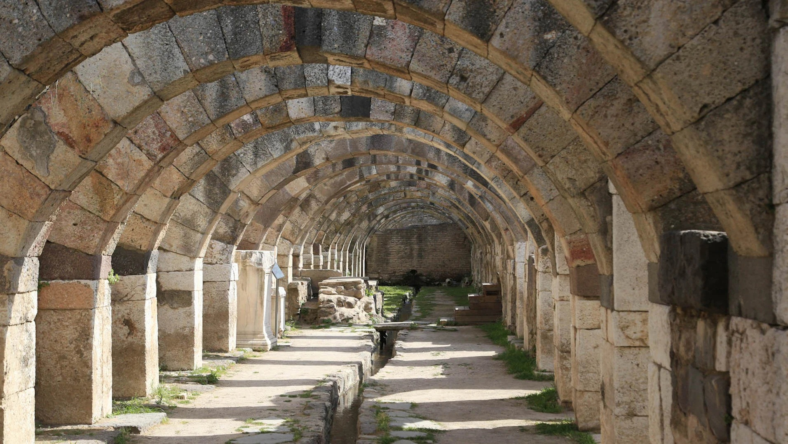
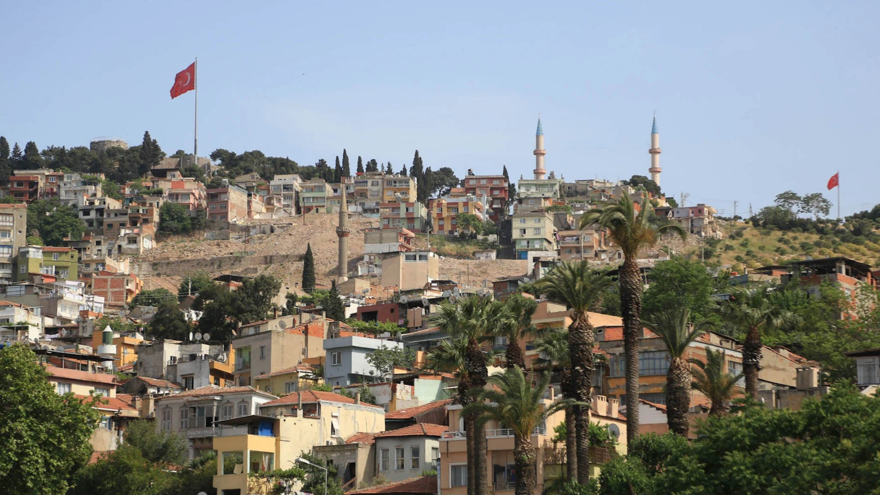
Smyrna – Revelation 2:8-11
The ancient marketplace of Smyrna still features beautiful arches and running water, which had been collected into cisterns for city use in ancient times. Photo by Karrie Sparrow.
Mosque minarets, Turkish flags, and palm trees line the hills of the ancient city of Smyrna, now Izmir, Turkey. Photo by Karrie Sparrow.
Notes:
https://www.imb.org/2018/06/01/what-happened-to-the-seven-churches-of-revelation/
What Happened to the Seven Churches of Revelation?
By Madeline Arthington and Karrie Sparrow
Smyrna-Izmir
The ruins of Smyrna’s marketplace are nestled in a city block of the thriving seaport city, Izmir. One of the oldest continuously inhabited cities of the world, Izmir is now home to more than four million people. When we pulled up to the ruins of ancient Smyrna’s marketplace, high school students spilled out from their school. They seemed ambivalent to the millennia-old city ruins across the street from them.
Jesus’s words to the believers in Smyrna encouraged them in the face of coming persecution. “Be faithful, even to the point of death, and I will give you life as your victor’s crown” (Rev. 2:10 NIV). Indeed, not just in Smyrna but across the entire region, first-century believers who resisted the pressure of imperial cult worship endured persecution. Some scholars think this persecution was often economic, like the loss of a job or financial wealth (Fairchild, p. 146). Probably for this reason, Jesus reminded them they are spiritually rich even though materially poor.
The early church father Polycarp was the bishop of Smyrna and a disciple of the apostle John. At the age of eighty-six, he was burned at the stake for refusing to renounce his faith in Christ. Some of Polycarp’s last words were, “For eighty-six years I have been his servant, and he has done me no wrong. How can I blaspheme my King who saved me?” (Wilson, p. 311).
The modern city of Izmir is filled with secular modernists—officially Muslim by name but sincerely disillusioned with Islam and the current political climate. They may know that Christians “used to” live in Izmir, but most are unaware of the thriving Christian community of up to five hundred believers scattered among at least twelve churches. Although many of these churches are historically Catholic or Orthodox, there is a growing number of evangelical Protestant believers as well.

Slide 15
Smyrna – Revelation 2:8-11
Message
Don’t be afraid
Be faithful until death
Notes:
Smyrna
Center of the Emperor cult. Forced to say “Ceasar is Lord.”
Polycarp, Bishop of Smyrna, given choice to renounce Christ or die… “Eighty and six years have I served Him (Christ), and He has done me no wrong. How can I blaspheme my King who saved me?”
Martyred: Feb 23, AD 155.

Slide 16
Pergamum – Revelation 2:12-17
Notes:
Dispensational View – from Constantine AD 312-606; a mingling of church and state
Historical View – a church facing false teaching, immorality, and idolatry
Spiritual View – Be faithful during times of persecution; Don’t mix truth with error

Slide 17
Pergamum – Revelation 2:12-17
¹² “And to the angel of the church in Pergamum write:
The One who has the sharp two-edged sword says this:
¹³ ‘I know where you dwell, where Satan’s throne is; and you hold fast My name, and did not deny My faith even in the days of Antipas, My witness, My faithful one, who was killed among you, where Satan dwells. ¹⁴ But I have a few things against you, because you have there some who hold the teaching of Balaam, who kept teaching Balak to put a stumbling block before the sons of Israel, to eat things sacrificed to idols and to commit acts of immorality. ¹⁵ So you also have some who in the same way hold the teaching of the Nicolaitans. ¹⁶ Therefore repent; or else I am coming to you quickly, and I will make war against them with the sword of My mouth. ¹⁷ He who has an ear, let him hear what the Spirit says to the churches. To him who overcomes, to him I will give some of the hidden manna, and I will give him a white stone, and a new name written on the stone which no one knows but he who receives it.’
Notes:
Tyndale
became the capital of the Roman province of Asia. About 15 miles inland, it did not have a good trading position. But, apart from its administrative importance, it was significant for its great library, said to have contained more than 200,000 parchment scrolls. Indeed, our word ‘parchment’ is derived from this name ‘Pergamum’. It was an [Vol 20: Rev, p. 70] important religious centre. People came from all over the world to be healed by the god Asclepius

Slide 18
Pergamum – Revelation 2:12-17
Introduction/Description of Jesus
¹² The One who has the sharp two-edged sword says this:
Praise/Commendation
¹³ ‘I know where you dwell, where Satan’s throne is; and you hold fast My name, and did not deny My faith even in the days of Antipas, My witness, My faithful one, who was killed among you, where Satan dwells.
Satan’s Throne
= Asclepius? Zeus? Emperor worship?

Slide 19
Pergamum – Revelation 2:12-17
Condemnation/Rebuke
¹⁴ But I have a few things against you, because you have there some who hold the teaching of Balaam, who kept teaching Balak to put a stumbling block before the sons of Israel, to eat things sacrificed to idols and to commit acts of immorality. ¹⁵ So you also have some who in the same way hold the teaching of the Nicolaitans.
Charge/Challenge
¹⁶ Therefore repent; or else I am coming to you quickly
Notes:
We cannot identify the error with certainty, but Balaam (see on v. 6) was the man who, after being prevented from cursing Israel, apparently advised Balak, king of Moab that the Israelites would forfeit God’s protection if he could induce them to worship idols (Num. 31:16). Became symbolic of spiritual decline… stumbling block = trap with tempting bait!
The Slaughter of Midian…And Moses said to them, “Have you spared all the women? Behold, these caused the sons of Israel, through the counsel of Balaam, to trespass against the Lord in the matter of Peor, so the plague was among the congregation of the Lord .
Numbers 31:15‭-‬16 NASB
https://bible.com/bible/100/num.31.15-16.NASB

Slide 20
Pergamum – Revelation 2:12-17
Consequences
¹⁶ …or else I am coming to you quickly, and I will make war against them with the sword of My mouth.
If we don’t repent, we may end up on the wrong side of a spiritual war!
Sword of My Mouth = Word of God; Truth!
Promise
¹⁷ …I will give some of the hidden manna, and I will give him a white stone, and a new name written on the stone which no one knows but he who receives it.’
Manna = miraculous provision; spiritual nourishment from the Word
white stone … new name = personal identity before God (“He Knows My Name”)
https://youtu.be/hXsiWoyjw60
Notes:
White Stone
With this is linked a white stone inscribed with a new name. This has puzzled commentators for centuries. At least seven suggestions have been made with some confidence. One arises from legal practice, where a member of a jury who was for acquittal handed in a white stone. A second view sees a reference to reckoning, since white stones were often used in calculations. A third idea is that the white stone is the symbol of a happy day (like our ‘red-letter day’). Along somewhat the same lines is that which sees the stone as an amulet bringing good luck. A more prosaic suggestion is that the white stone represented a ticket to bread and circuses. A sixth suggestion arises from a rabbinic speculation that when the manna fell from heaven it was accompanied by precious stones (note that manna has just been mentioned). The seventh view is that the reference is to a stone in the breastplate of the high priest with the name of one of the tribes written on it. A variant sees a reference to the Urim (Exod. 28:30). Some of these may legitimately be criticized on the ground that either the stone is not white or it has no inscription. But none of them carries complete conviction. We simply do not know what the white stone signified, though clearly it did convey some assurance of blessing.
New Name
This must be understood in the light of ideas held in antiquity about the function of a name. With us a name is no more than a distinguishing mark, a label. But in antiquity the name was widely held to sum up what the man stood for. It represented his character. It stood for the whole man. Here then the new name represents a new character. The fact that no-one knows it would be a crippling disadvantage for us. In the modern world what is the use of a name that nobody knows? But for people of antiquity the hidden name was precious. It meant that God had given the overcomer a new character which no-one knew except himself. It was not public property. It was a little secret between him and his God.

Slide 21
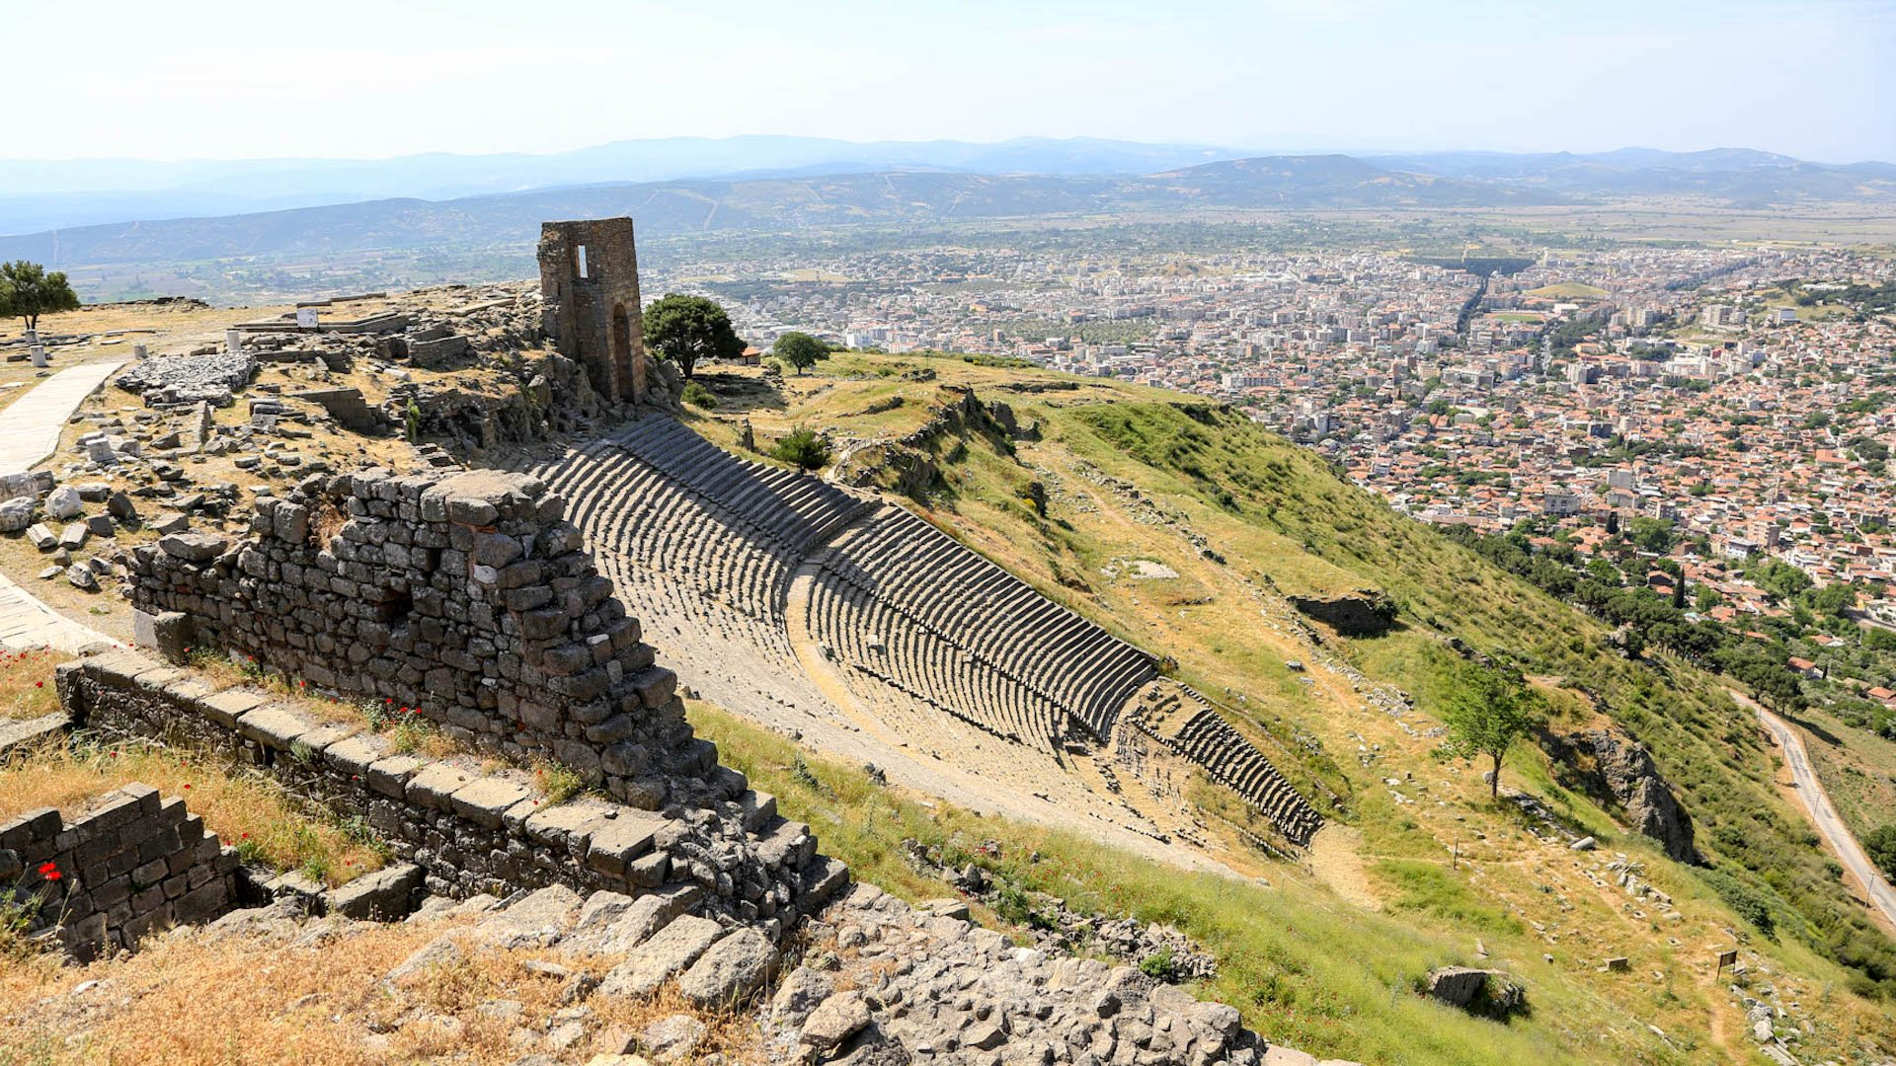
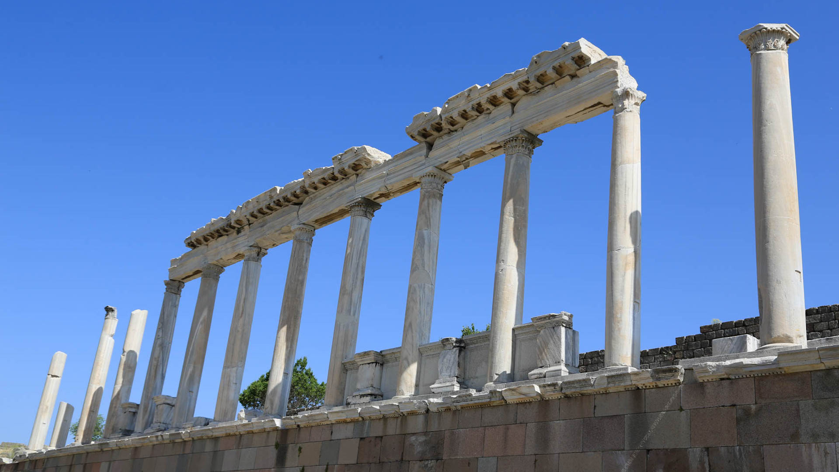
Pergamum – Revelation 2:12-17
The temple of the Roman emperor Trajan was used for the worship of Zeus on the upper acropolis of Pergamum, Turkey. Photo by Karrie Sparrow.
The acropolis and an ancient amphitheater that seats ten thousand people overlook the city of Pergamum, now modern-day Bergama, Turkey. Photo by Karrie Sparrow.
Notes:
https://www.imb.org/2018/06/01/what-happened-to-the-seven-churches-of-revelation/
What Happened to the Seven Churches of Revelation?
By Madeline Arthington and Karrie Sparrow
Pergamum-Bergama
The ruins of Pergamum sit atop a hill overlooking the modern-day city of Bergama. A state-of-the-art cable car carried us to the top of the hill where we viewed extensively excavated ruins. Pergamum was a principal city of the Roman empire in the first century. The most striking remnant is the steep theatre built into the side of the hill.
But it was the ruins of the temple to Zeus that sobered me. Some think this temple is why Jesus called Pergamum the place where Satan has his throne. Jesus had some serious warnings toward Christians in Pergamum who had fallen away from his teaching to embrace sinful behaviors. If they did not repent, Jesus himself would come and fight against them. Jesus did, however, commend the few in Pergamum who stood strong and didn’t renounce their faith even when their friend Antipas was killed (Rev. 2:13).
Today, Bergama is made up of an “old city” of narrow, cobbled streets and a more modern city. The locals I interacted with didn’t disappoint as they extended their famous Turkish hospitality. Happy to offer information, one man told me Christians visit the seven churches like Muslims visit Mecca—to earn merit before God. My heart dropped to hear his misunderstanding of Christianity. Today, there are a few known believers around Bergama, but no churches.
The way to the Asclepion of Pergamum, perhaps the ancient world’s most famous medical center. Photo by Karrie Sparrow.

Slide 22
Pergamum – Revelation 2:12-17
Message
Don’t mix Truth with error
Repent of immorality and idolatry
Expect the soon return of Jesus
Notes:
White Stone
With this is linked a white stone inscribed with a new name. This has puzzled commentators for centuries. At least seven suggestions have been made with some confidence. One arises from legal practice, where a member of a jury who was for acquittal handed in a white stone. A second view sees a reference to reckoning, since white stones were often used in calculations. A third idea is that the white stone is the symbol of a happy day (like our ‘red-letter day’). Along somewhat the same lines is that which sees the stone as an amulet bringing good luck. A more prosaic suggestion is that the white stone represented a ticket to bread and circuses. A sixth suggestion arises from a rabbinic speculation that when the manna fell from heaven it was accompanied by precious stones (note that manna has just been mentioned). The seventh view is that the reference is to a stone in the breastplate of the high priest with the name of one of the tribes written on it. A variant sees a reference to the Urim (Exod. 28:30). Some of these may legitimately be criticized on the ground that either the stone is not white or it has no inscription. But none of them carries complete conviction. We simply do not know what the white stone signified, though clearly it did convey some assurance of blessing.
New Name
This must be understood in the light of ideas held in antiquity about the function of a name. With us a name is no more than a distinguishing mark, a label. But in antiquity the name was widely held to sum up what the man stood for. It represented his character. It stood for the whole man. Here then the new name represents a new character. The fact that no-one knows it would be a crippling disadvantage for us. In the modern world what is the use of a name that nobody knows? But for people of antiquity the hidden name was precious. It meant that God had given the overcomer a new character which no-one knew except himself. It was not public property. It was a little secret between him and his God.

Slide 23
END HERE JUNE 3, 2020
BEGIN HERE JUNE 10, 2020

